Slide 1
INTERIOR DESIGN WEBSITE

Slide 2

TEAM MEMBERS
T L : SAKAASH S
ARUN GANGA RAJ D
KISHORE KUMAR S
AJEETH KUMAR P
AISHWARYA A
KALAI SELVI T
NIRANJAN R
HEMNATH M
SHURUTHI R
VELAN C

Slide 3
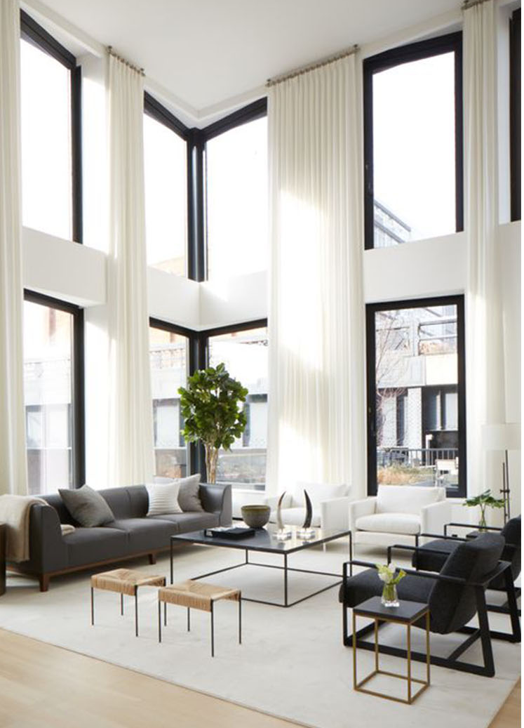
OBJECTIVE
The main objective is to develop a comprehensive website to overcome the shortcomings of the existing system.
Features to build or renovate or model a space that user may opt varying with scalability of lavish luxury apartments to cubicles and caravans are included.
The aim is to instill design ideas to people unbeknownst of its significance by providing a plethora of interior design ideas . It also provides budget friendly services and is accessible to disparate users and clients.

Slide 4
MOTIVATION
Interior design is a creative practice that analyzes programmatic information, establishes a conceptual direction, refines the design direction, and produces graphic communication and construction documents.
As an interior design business, image is everything for Qub Design. Needless to say, their website had to reflect this in a way that would attract new clients and inspire the existing ones.
This project is developed to create a comprehensive website full of high-quality images, without taking them forever to load and to provide services despite the aspect of scalability. Another business concern was embracing the constant change of interior design trends without consistently redesigning the website.

Slide 5

ABSTRACT
Interior Design is about creating experiences that address, protect, and respond to the need of humans. The main objective of our project is to develop a comprehensive website that include features to ease the user's decor voyage and provide users with an online experience for visualizing the space they opt to design,rebuild, model or renovate.
Interior Decor Visualization website gives a clear user Interface as to what detail the user requires, the distinct features and design styles that showcase various trends a client might want to emulate

Slide 6
ABSTRACT
Customization and personalization are at the core of the concept. This project helps the user to avail a interior designer and renovate or build or style a caravan, professional work space and home space that may vary in the aspect of scalability
Interior Decor Visualization aimes in instilling design ideas to people unbeknownst of its significance by providing a plethora of interior design ideas. It also provides budget friendly services and is accessible to disparate users and clients

Slide 7
METHODOLOGY
Interior decor websites provides a more conventional solutions to the design challenges posed by users. They lacks in its services to meet the requirements of users with minimal budget who envision a space devoid of luxury and expensive accessories.
IDV includes the development of a dynamic and comprehensive website for interior decor business. It also eases user's design quest by dispalying the vision board for design process.
This is done by using Hyper Text Markup Language, Cascading Style Sheets, JavaScript and PHP techologies to make a interactive sleek user interface for the website. XAMPP server is used to create login page and retrieve data

Slide 8
LITERATURE SURVEY
S.NO | PAPER TITLE | JOURNAL YEAR | CONCEPT & METHODOLOGY | ADVANTAGES | DRAWBACK
1. | The effect of Web interface features on consumer online purchase intention | January 2009 | The purpose of this research is to find internet features, specifications and attempts to know whether or not different internet features are effective on marketing process. The proposed study has designed a questionnaire in Likert scale. | The results of this study provide important insights into the online consumer experience. Determines a meaningful effects of income, | The population of survey includes people with internet access,hence the sample size is low Paying attention to internet web Specification is necessary

Slide 9
LITERATURE SURVEY
S.NO | PAPER TITLE | JOURNAL YEAR | CONCEPT & METHODOLOGY | ADVANTAGES | DRAWBACK
2. | Evaluation of Sustainable Environment- Friendly Interior Decoration Design from the Perspective of Economy. | 9 April 2022 | This system seeks a low carbon and Sustainable devlopment direction, and Proposes sustainable Development Counter measures. Air quality detector is used to test the indoor air quality for harmful substances such as carbon monoxide | Creates an ecological interior design scheme Minimizes radio active pollution of the indoor Environment | Long term development process Unilateral consideration cannot achieve best indoor effect

Slide 10

HARDWARE REQUIREMENTS
Processor: Minimum 1 GHz; Recommended 2GHz or more
SOFTWARE REQUIREMENTS
Chrome web browser
Ethernet connection (LAN) OR a wireless adapter (Wi-Fi)
Hard Drive: Recommended 64 GB or more
Memory (RAM): Recommended 4 GBor above
Visual Studio Code - Source code editor
XAMPP - Web Server Solution Stack Package
Operating System

Slide 11
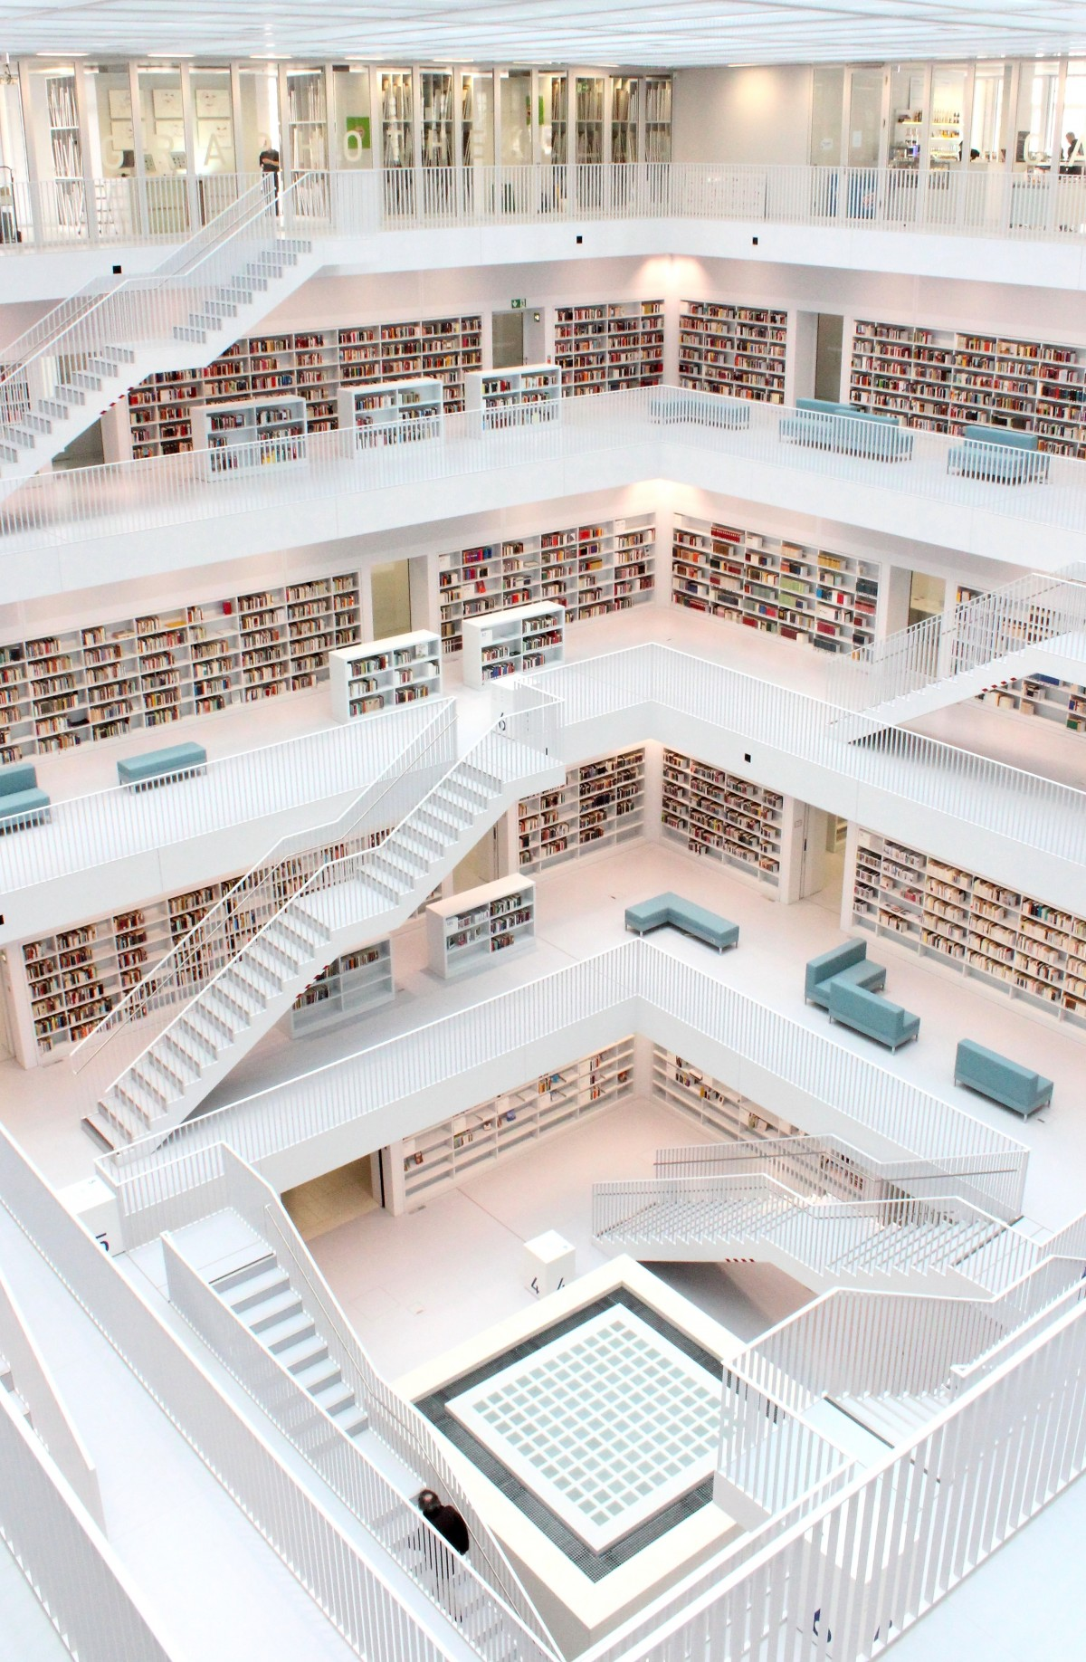
SYSTEM ANALYSIS AND DESIGN
1
2
The Home page includes the Executive projects of various designers are displayed for the users to discover their tastes and priorities and take and relevant information for future account.
The System is used to provide users with an online experience for visualizing the space they opt to design, rebuild, model or renovate.
3
The user information will be validated to create an account, later logging in the user can access the website.

Slide 12
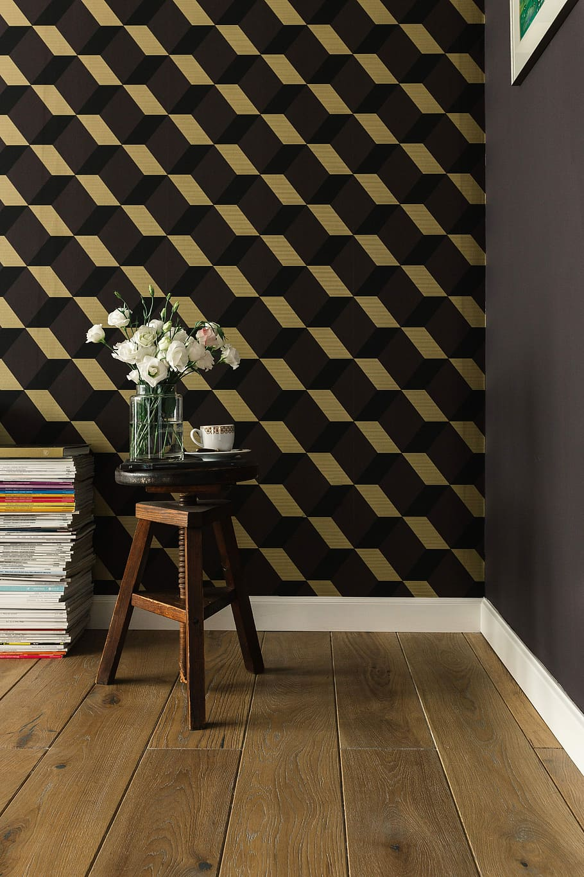
SYSTEM ANALYSIS AND DESIGN
4
5
Testimonials of clientele has been displayed that convinces new clients about work ethic of organization.
It also includes a glimpse of the services provided so users can avoid going through the tedious process of contacting designers.
6
The About us page includes the details and the contact information of the organization. It also includes the brief description of the design strategies to be employed during the process.

Slide 13
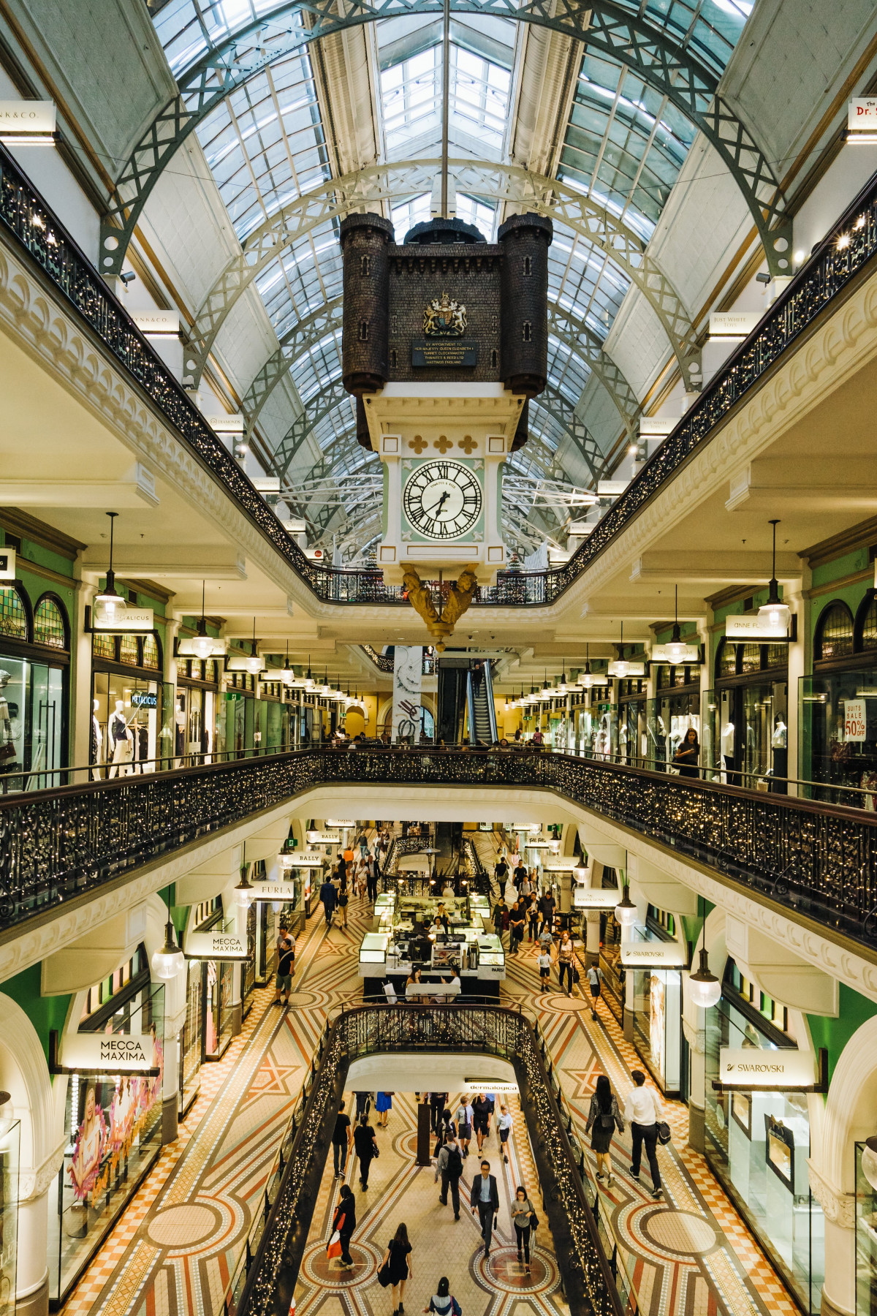
SYSTEM ANALYSIS AND DESIGN
7
The Service page showcases all the interior design services, contemporary interiors architecture, projects and lifestyle product The users can find latest trends, decoration tips and renovation ideas
8
The contact us page includes the contact form to gather details to contact the customers. Description about company is provided to explain why new prospects should contact us using the form published on the right side.

Slide 14
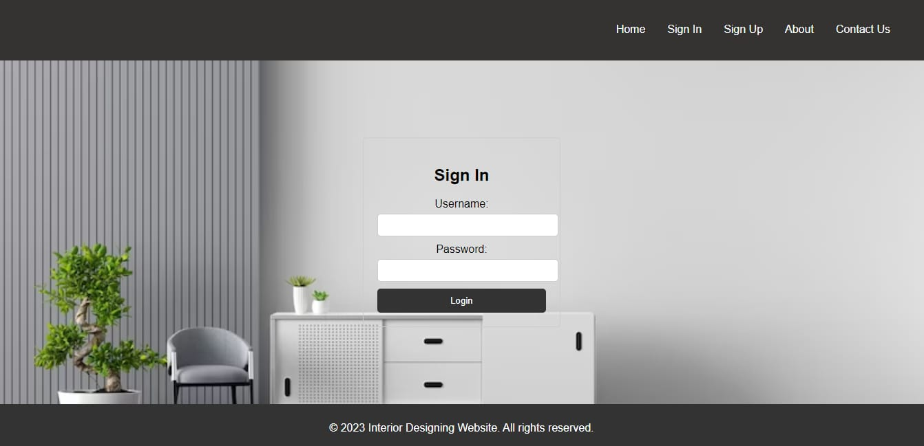
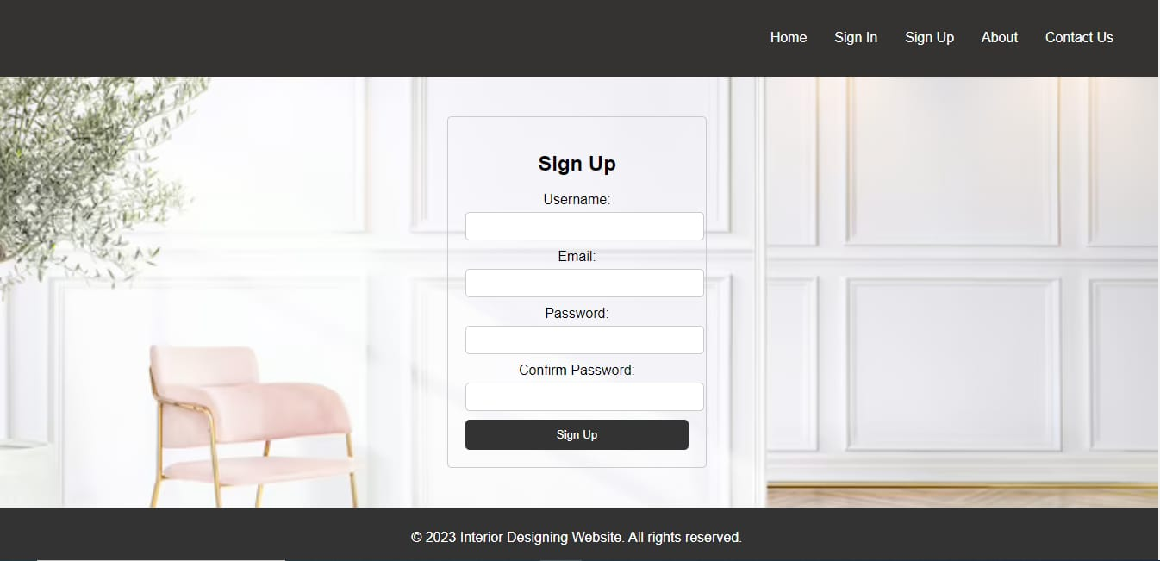
MODULE

Slide 15
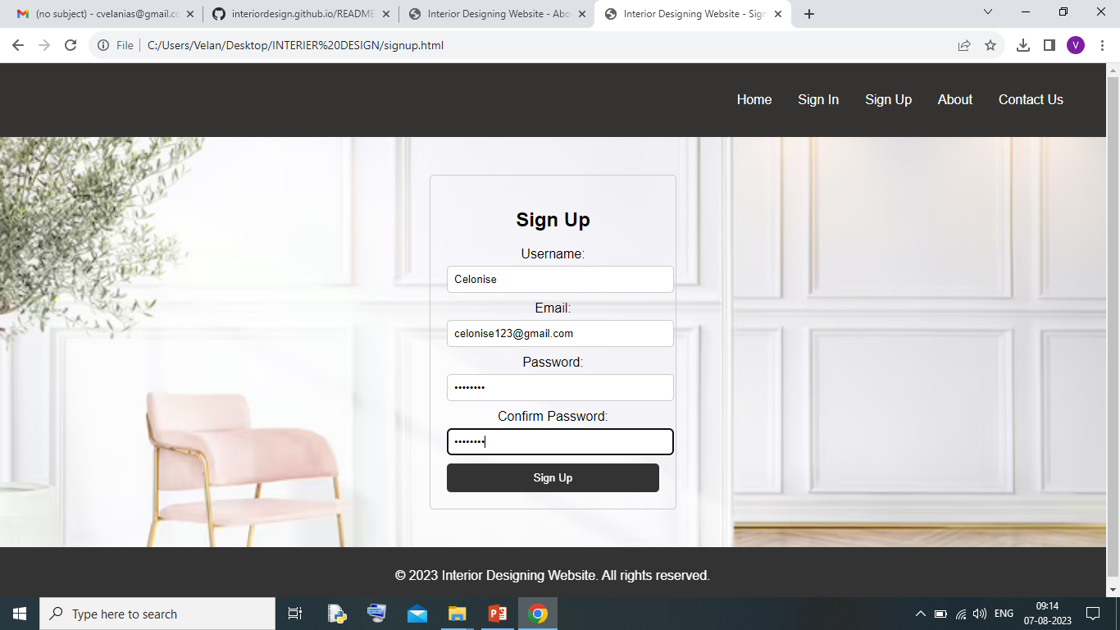
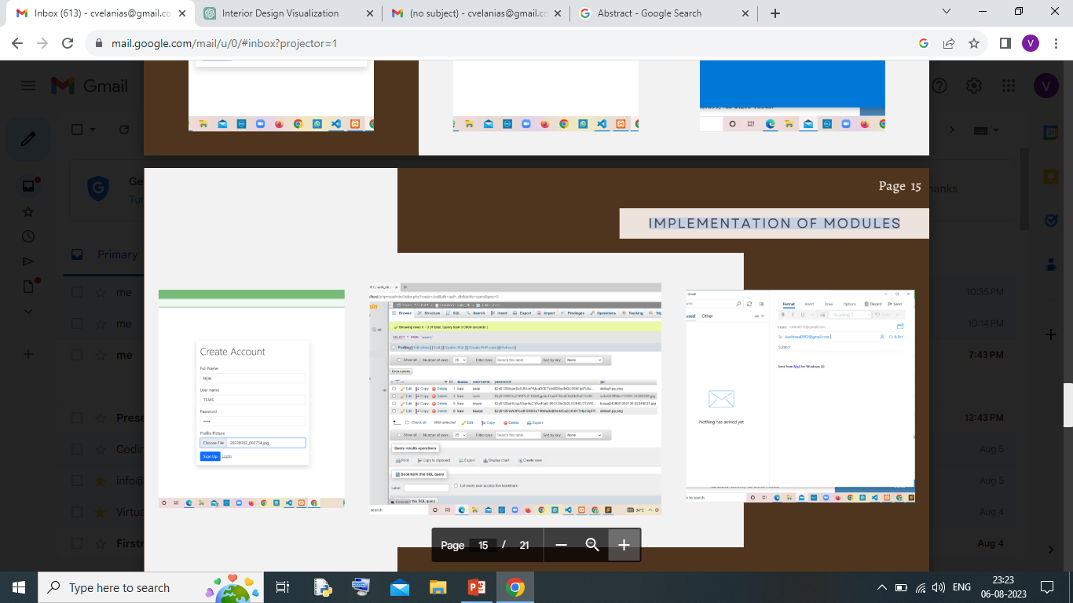
IMPLEMENTATION OF MODULES

Slide 16
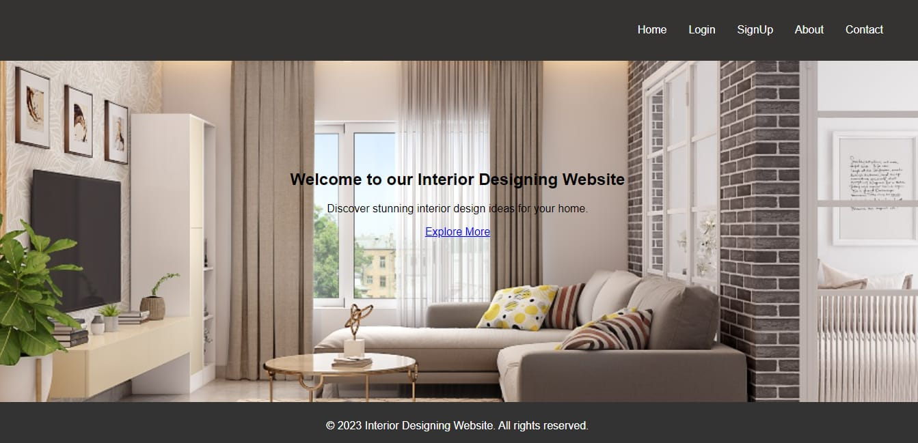
OUTPUT
HOME

Slide 17
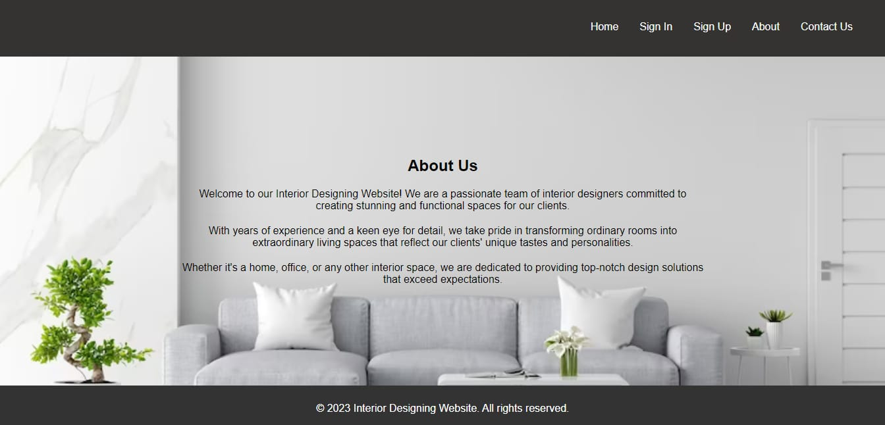
OUTPUT
ABOUT US

Slide 18
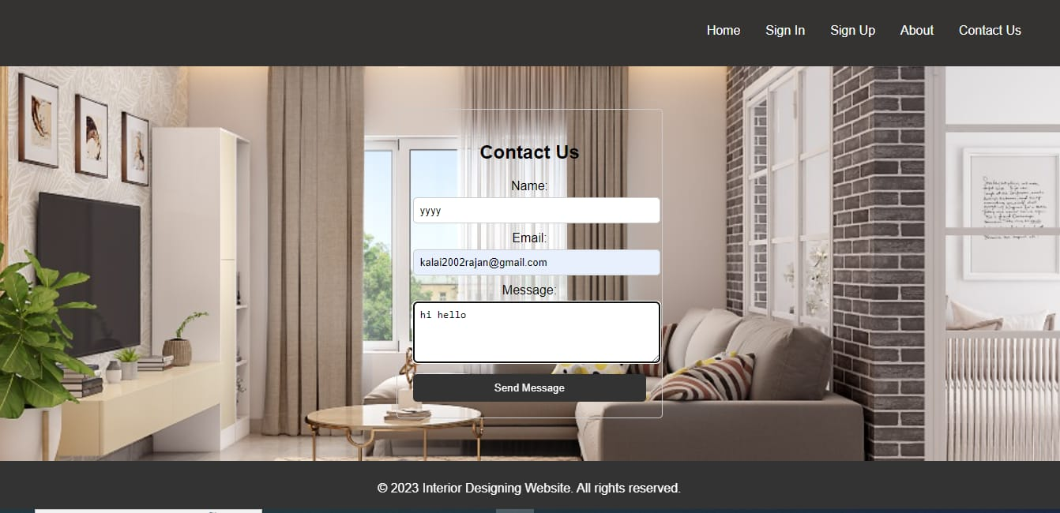
OUTPUT
CONTACT US

Slide 19
FUTURE WORK
Mood boards will be created to assist the users envision the design of their space
Vision board will be created to emphasis on the processes involved in the design voyage
FAQ section will be included to Reflect and respond to the audience’s needs wholly and thoroughly

Slide 20
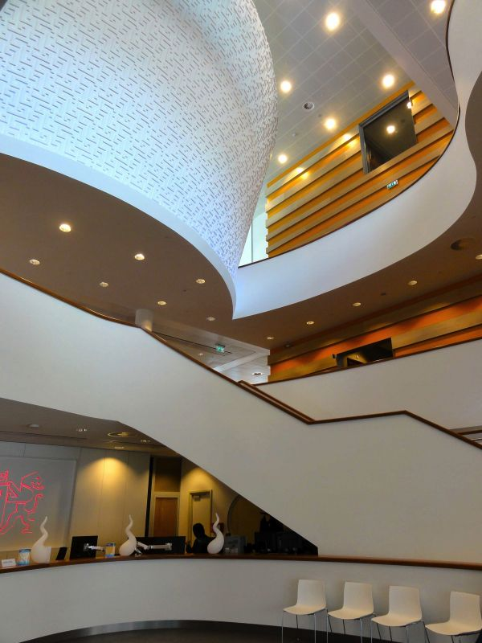
CONCLUSION
Interior decor can be a troublesome issue for most of the people. It is very inconvenient when people need to physically be there to consult a designer and review all their prior decor works. Therefore, the interior decor visualization website is needed solve this issue. The to system's main function is for the users to be able to contact the designers and explore plethora of decor works that are designed for spaces varying in scalability and to review the feedback provided by clientele through the online system, therefore they don't have to personally visit places. They can stay at home and contact designer when the time is scheduled for their appointment

Slide 21
THANK YOU

